Slide 1


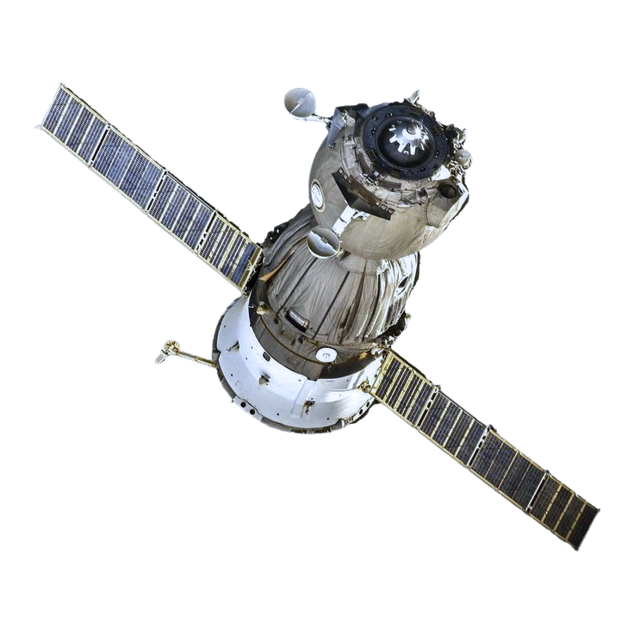


FLAI
Challenge: Data Pathways to healthy cities and human settlement
Presented by: TengriSpace

Slide 2


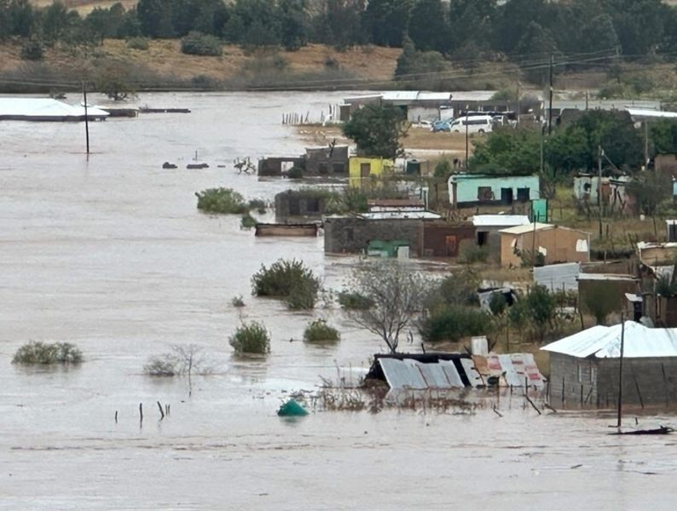
Statistics:
~300000
people were affected by the 2024 floods, the worst in 80 years, with 119,000 evacuated across 10 regions.
200 billion KZT
is lost annually due to floods, seven times higher than from other natural disasters.
2-4 TIMES
above normal rainfall in 2025 triggered another wave of floods, forcing evacuation of people and livestock in northern regions.
Relevance
In spring 2024–2025, rapid snowmelt and heavy rains caused rivers to overflow across northern and eastern Kazakhstan, flooding thousands of homes in Petropavl, Astana, and Almaty. In April alone, rainfall was 2–4 times above normal, and temperatures rose by 3–8°C, forcing the evacuation of hundreds of thousands of people.

Slide 3

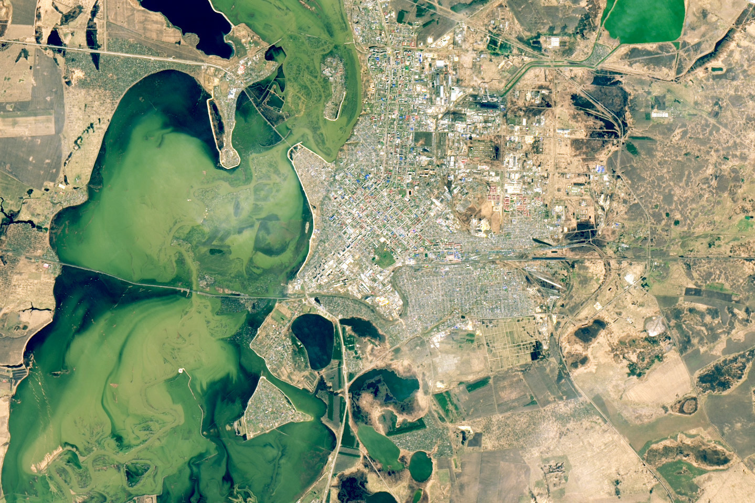

Petropavl
Petropavl
Flooded communities
Teplichnoye
Teplichnoye
Esil
river
Esil
river
April 25, 2025
Hypothesis
Project Goal
The use of AI to analyze NASA satellite data, hydrological models, and real-time monitoring will enable flood prediction with accuracy above 85%, 3D visualization, and the generation of scenarios for redirecting excess water into reservoirs and irrigation systems, thereby reducing damage and losses.
To develop a web and mobile AI-based application for early flood warning with 3D visualization of scale and trajectory, integration of official data, and practical recommendations for water resource management for authorities and farmers.

Slide 4


SWOT analysis of our analogues
Analogues | Strengths | Weaknesses | Opportunities | Threats
HydroPost KZ | Tailored for Kazakhstan Free access User-friendly | No notifications Limited to Kazakhstan Lack integrations | Add push alerts Expand to nearby countries | Global apps like Google Flood Hub Reliance only on government data.
Google Flood Hub | AI-driven 20–30% more accurate Covers 700M people including Kazakhstan | No local sensors Tied to Google ecosystem. | Partner with local authorities Expand to 150+ countries | Antitrust risks Competition from independent apps
PegelAlarm (EU) | Custom push/SMS/email alerts Strong EU coverage | 1–6 hour forecast delays Mainly Europe-focused. | Expand to new regions (e.g., Chile, Spain 2025) Add weather integration. | Local apps Data delays from external sources
GloFAS (EU) | 30-day forecasts for 169 countries Free for emergency teams | Web-only No mobile alerts Maintenance disruptions | Develop mobile app Integrate with IoT | EU funding dependency Competition from AI apps like FLAI

Slide 5


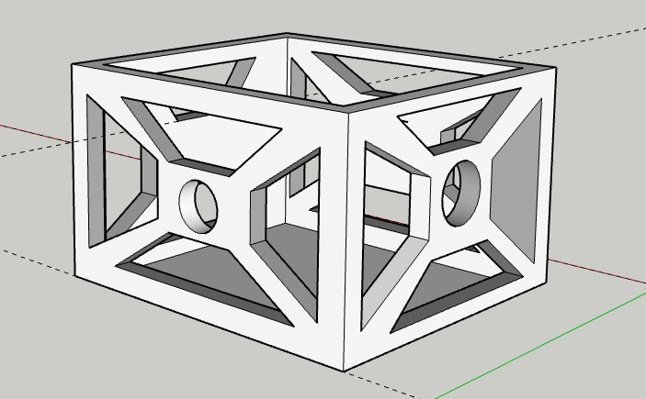
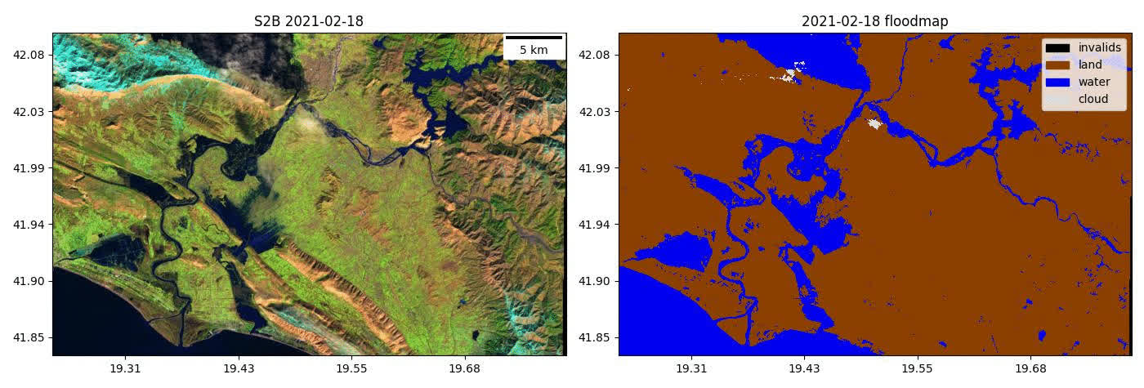
3D model of satellite
Forecast of the flows and possible floods
MODEL

Slide 6


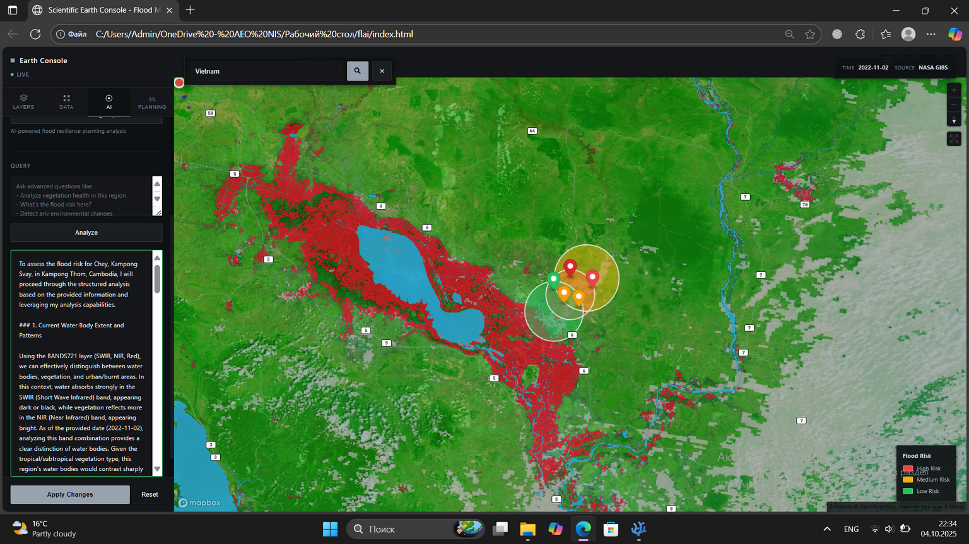


Interface of our site

Slide 7


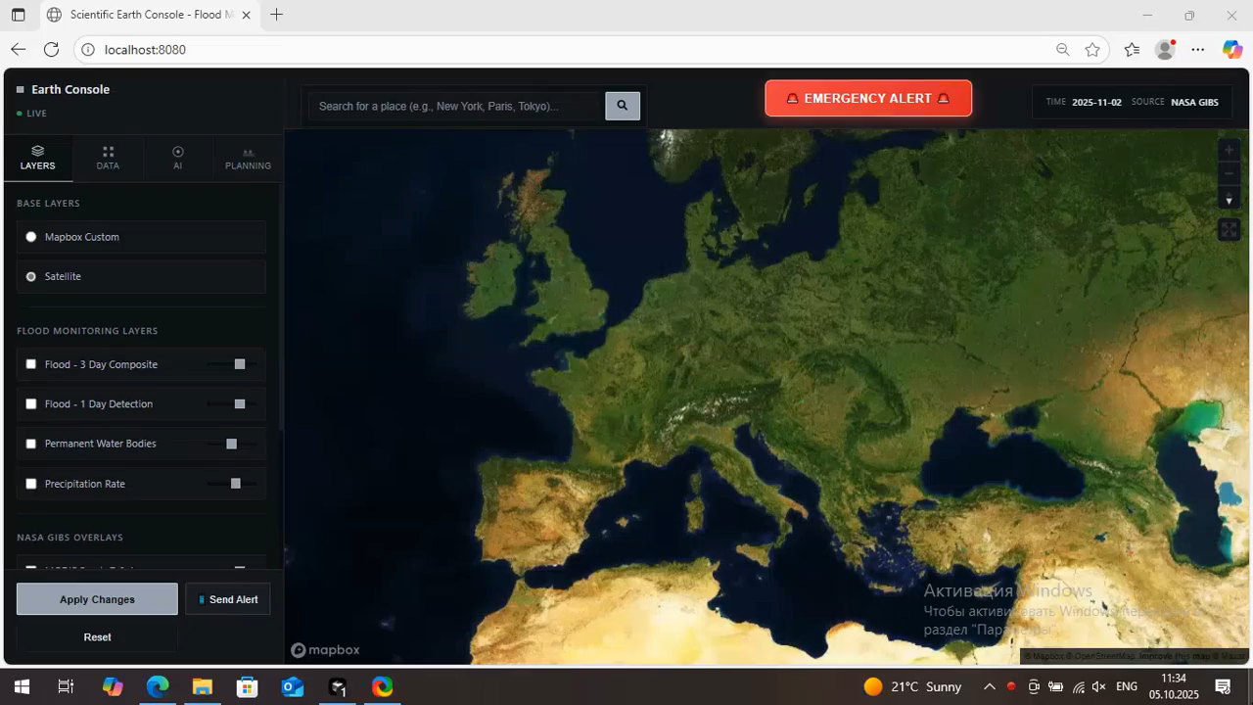
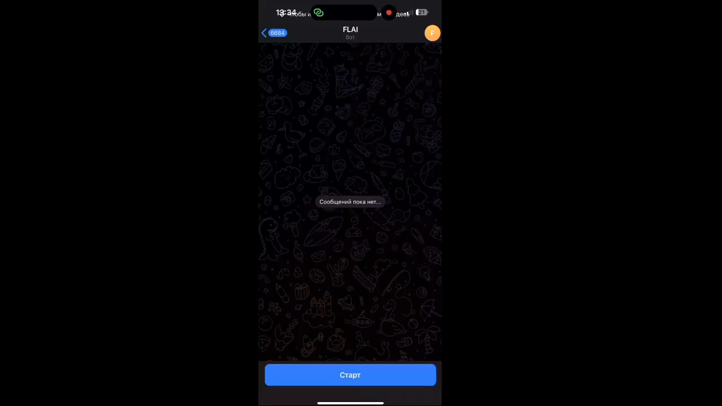
Thanks for watching!
Our future developments
flood maps accurate to the level of a single block updates every few minutes smart alert system launching our own FLAI satellite

